Slide 1
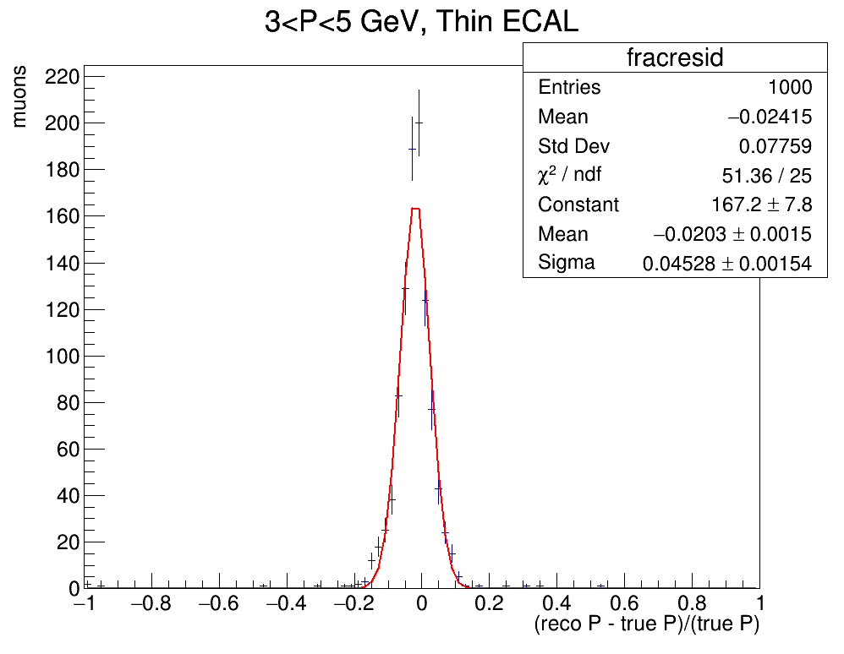
SIMULATION EXERCISE
Muon resolution garsoft simulation: 1000 randomly generated upstream muons entering the Gas TPC with initial momentum 3<P<5 GeV
Simulation Goal: Reconstruct the muon momenta and produce a reconstruction resolution plot
Exercise goal: Reproduce the resolution plot with a new randomly generated muon set

Slide 2
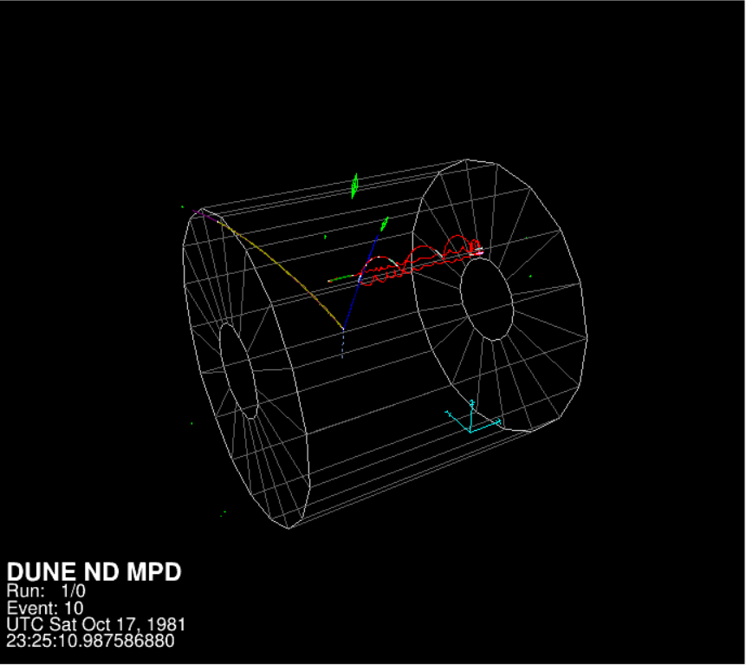
THE GARSOFT TUTORIAL
To familiarise with garsoft I firstly followed the garsoft tutorial which consists of four steps:
1000 Event sample generation via GENIE MC generator (prodgenie.fcl)
Readout simulation (readoutsimjob.fcl)
Reconstruction (recojob.fcl)
Creation of a simplified analysis root tree (anajob.fcl)
Event from the tutorial production visualiased with garsoft visual display (evd.fcl)

Slide 3
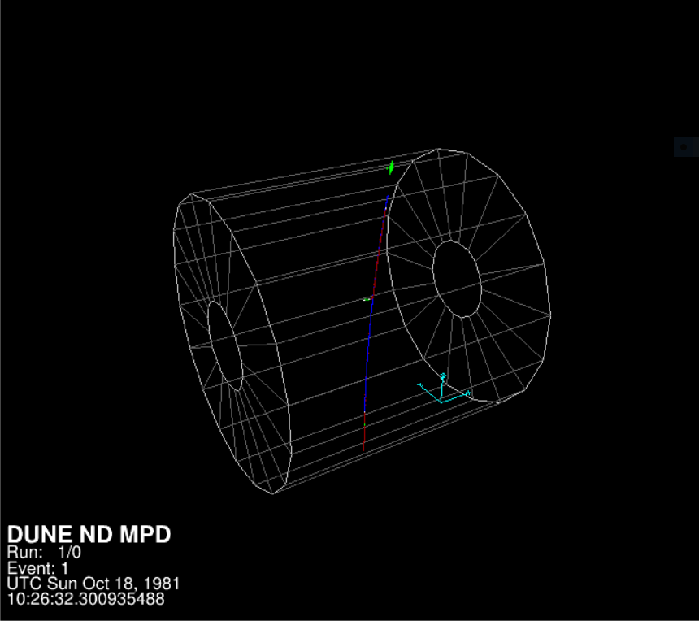
REPRODUCING TOM’S SIMULATION
Generate a text file (using Tom’s root macro) with instructions to produce 1000 upstream muons entering the Gar detector : initial momentum on the z direction(i.e. parallel to flux) that varies between 3 GeV and 5 GeV respectively; fixed z coordinate at 1000 cm (in the ND hall coordinates) ; x and y coordinate that vary between -200 and 200 cm and -200 and 0 cm respectively
Generate simulation using text file (different from Garsoft tutorial)
Execute readout simulation, reconstruction and convert into analysis tree (same as GarSoft tutorial)
Use root macro to produce resolution plot and compare with Tom’s
Upstrem muon visualised with garsoft visual display (evd.fcl)

Slide 4
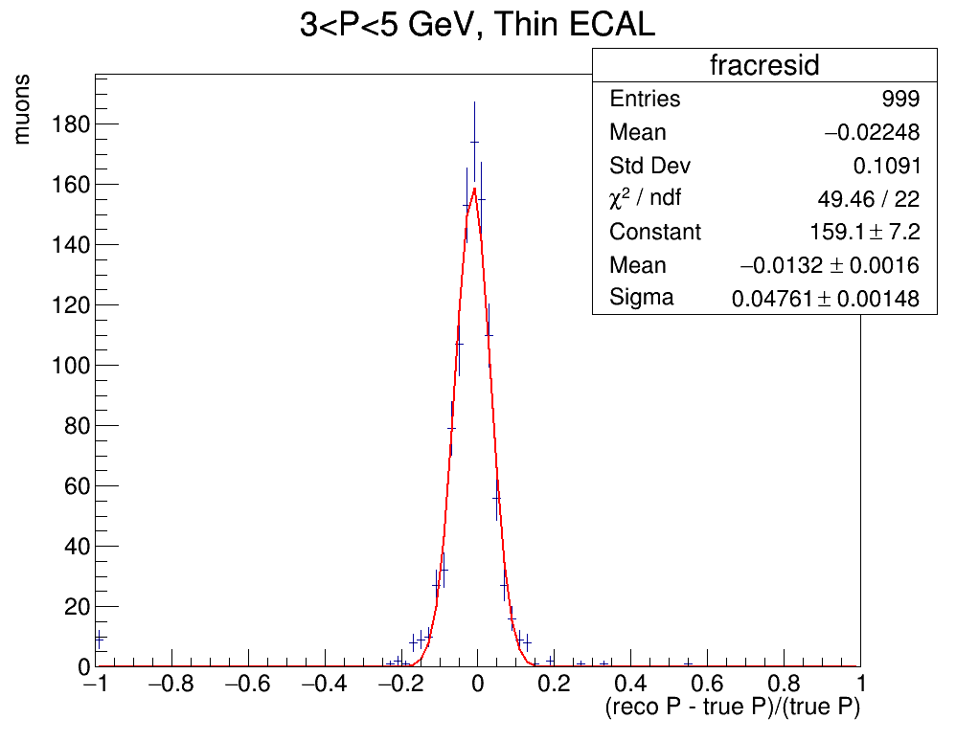
PLOTS COMPARISON
TOM’S PLOT
MY PLOT

